Slide 1
Logistic Regression part 1

Slide 2
A A A A A A
A A A A A A A A
A A A A A A
z = w1 x1 + w2 x2 + b
z = <w1, w2> <x1, x2> + b
= w.x + b
Where w = <w1, w2>
x = <x1, x2>
x2
B B B B B B B
B B B B B B
B B B B B
x1
If we insert x1 and x2 values for any object of class A, z will be positive
If we insert x1 and x2 values for any object of class B, z will be negative
We can say that if z>0 class is A otherwise class is B

Slide 3



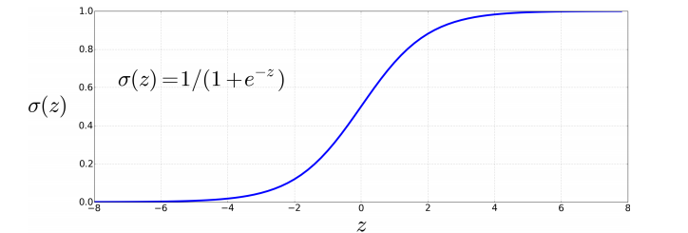
For n feature vectors or attributes
Z
= w1x1+w2x2+w3x3+…………………+wnxn+b
If z>0 then Ϭ(z) > 0.5
If z <= 0 then Ϭ(z) <= 0.5
Ϭ(z) denotes the probability of belonging to a class

Slide 4
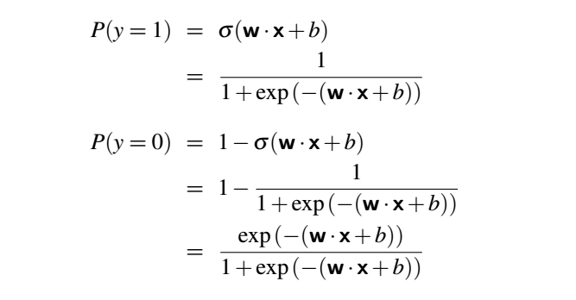
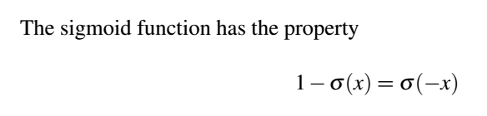
Derivative of Ϭ(z) = Ϭ(z) ( 1- Ϭ(z))

Slide 5
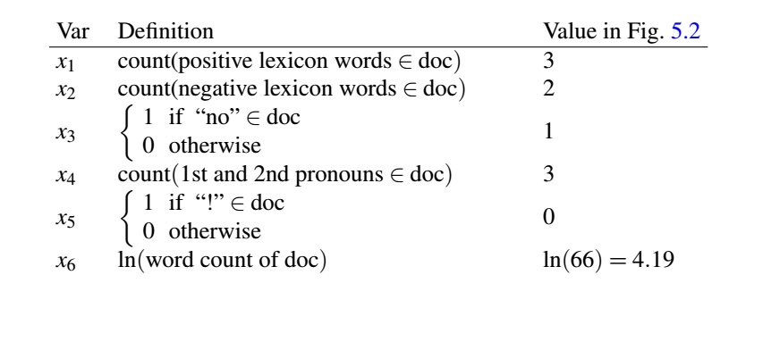
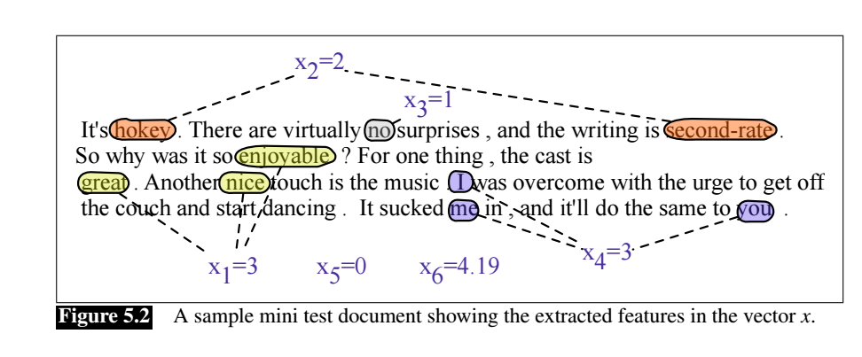

Slide 6
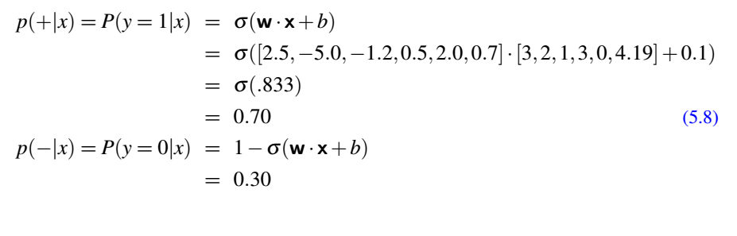
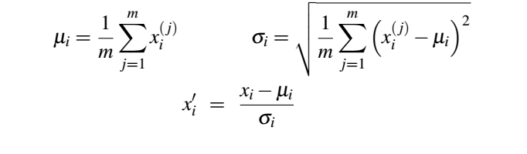
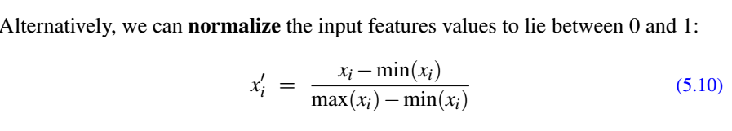
Scaling input features

Slide 7
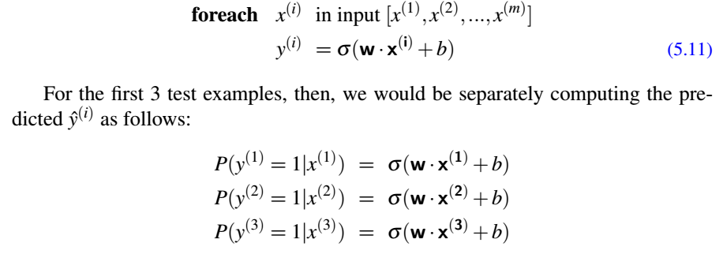
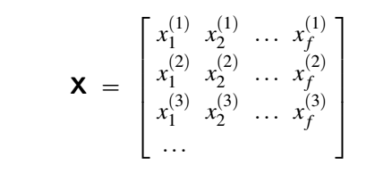
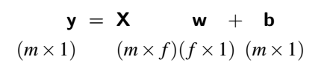
Processing multiple examples in matrix form
Y = Ϭ (XW + b)

Slide 8
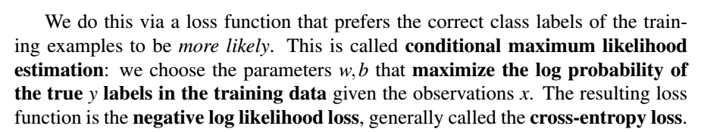

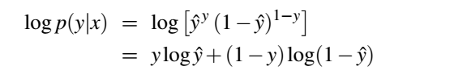
To derive the parameters w1, w2, w3, ……. and b, we will define a Loss function.
We will start with some random values of w1, w2, w3, …… and b and iteratively
update the values using gradient descent until the loss function becomes minimum.
For every example x maximize P(y = 1|x) or P( y = 0 |x)
Maximize
Maximize

Slide 9

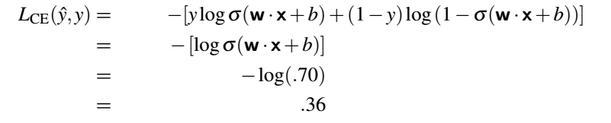
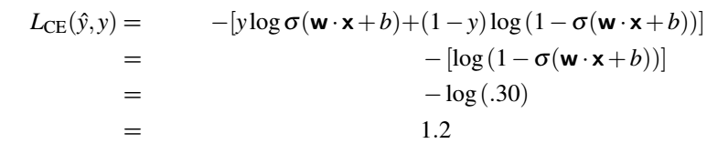

Slide 10



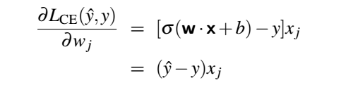
To update any parameter w, we will use gradient descent approach.
We need to take gradient of the Loss function with respect to the parameter w
For z = w1 x1 + w2 x2 + b
w1 = w1 – ղ (ŷ – y) x1
w2 = w2 – ղ (ŷ – y) x2
b = b – ղ (ŷ – y)

Slide 11
